Slide 1



Biology Toolkit
Quantifying Biodiversity
+
+
+
= ?
US Department of
Homeland Security
Notes:
1
1

Slide 2
Goals:
1. Be able to define biodiversity
2. Be able to define species richness and species evenness
3. Be able to use the equation called Simpson’s Index of Biodiversity to explain biodiversity in an area, and relate this index to probability

Slide 3
What does biodiversity mean to you
?

Slide 4
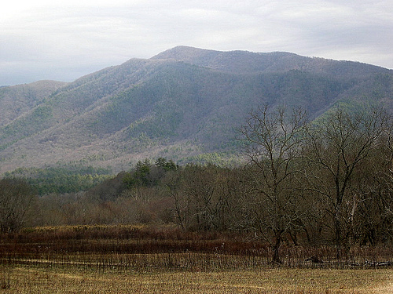
What is Biodiversity to an Ecologist?
Biodiversity is a measure of the different kinds of organisms in a region or other defined area.
Biodiversity includes the number of species and the distribution of individuals among the species.

Slide 5
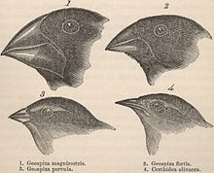
What is Biodiversity to an Ecologist?
Biodiversity can also refer to species’ range of adaptations, which are traits that can be behavioral, physical, or physiological. These traits enhance an organism’s fitness (ability to pass on its genes to another generation through reproduction)
Darwin’s Finches

Slide 6
Biodiversity
Biodiversity takes into account:
Species richness: the number of species in a region or specified area
Species | Number of Individuals
E. Redbud | 3
Black Oak | 4
Post Oak | 5
White Pine | 3
Honey Locust | 1

Slide 7
Biodiversity
Biodiversity takes into account:
Species richness: the number of species in a region or specified area
Species evenness: the degree of equitability in the distribution of individuals among a group of species. Maximum evenness is the same number of individuals among all species.
Species | Number of Individuals
E. Redbud | 3
Black Oak | 4
Post Oak | 5
White Pine | 3
Honey Locust | 1

Slide 8
Biodiversity
Biodiversity takes into account:
Species richness: the number of species in a region or specified area
Species evenness: the degree of equitability in the distribution of individuals among a group of species. Maximum evenness is the same number of individuals among all species.
Species | Number of Individuals
E. Redbud | 5
Black Oak | 5
Post Oak | 5
White Pine | 5
Honey Locust | 5

Slide 9


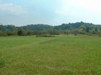
Okay, Ecologists … Get ready for data!
An ecologist goes out into the field and collects information from two separate plots of the same size but with one big difference: Plot 1 is in the woods and Plot 2 is in a pasture. The ecologist is interested in the types of insects that are found in the plots and whether there is a difference between the two plots.
What will we find out?

Slide 10

First! Make Your Hypothesis
A hypothesis is an educated guess based on knowledge
A hypothesis can be either accepted or rejected based on the collected data and data analysis
Based on the hypothesis, predictions can be made about answers to biological questions.

Slide 11
Examples of Hypotheses
There is water on Mars. True! Almost all of it is ice. Source: NASA
The global temperature of our planet has risen. True! Between 1906 and 2007, the global surface temperature has risen 0.74ºC [±.18]. Source: IPCC
More people in this room like Justin Bieber than do not like him. Test it out – what did you find?
What would be a good hypothesis for our ecologist?

Slide 12
Examples of Hypotheses
There is water on Mars. True! Almost all of it is ice. Source: NASA
The global temperature of our planet has risen. True! Between 1906 and 2007, the global surface temperature has risen 0.74ºC [±.18]. Source: IPCC
More people in this room like Justin Bieber than do not like him. Test it out – what did you find?
What would be a good hypothesis for our ecologist?

Slide 13
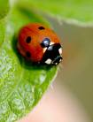
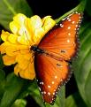

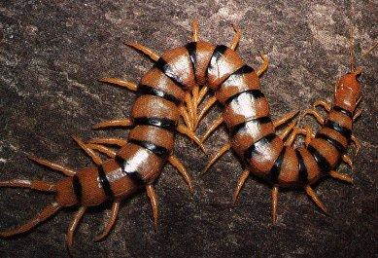
Field Data
Species | Plot 1 Woods | Plot 2 field
Centipedes | 50 | 10
Millipedes | 36 | 50
Butterflies | 35 | 0
Lady bugs | 55 | 39

Slide 14

Based on the data:
Which plot has more species richness?
Which plot has more species evenness?
Which plot has more biodiversity?
Notes:
Have students come up with their answers with their neighbors. Make sure to ask if their hypothesis was right or wrong.

Slide 15
Answers:
Plot 1, the woods, has more species richness. In plot 2, the pasture, there are no butterflies. Plot 1 has 4 species while Plot 2 only has 3 species present.
Plot 1 also has more species evenness. There is close to the same number of individuals in each group.
Therefore, plot 1 is more diverse than plot 2 because species richness is higher and the species are more evenly distributed

Slide 16
What if your data looked like this?
Species | Plot 1 Woods | Plot 2 field
Centipedes | 50 | 1
Millipedes | 36 | 1
Butterflies | 35 | 30
Lady bugs | 55 | 39
Grasshoppers | 0 | 40
Notes:
Ask students to think about it and then choose by a show of hands which they think is more diverse. Then explain that is hard to tell, just by looking at this data set. People could argue it for either side.

Slide 17
What if your data were more complicated?
Species | Plot 1 Woods | Plot 2 field
Centipedes | 50 | 1
Millipedes | 36 | 1
Butterflies | 35 | 30
Lady bugs | 55 | 39
Grasshoppers | 0 | 40
Maybe more evenness?
Maybe more richness?
Which one has more biodiversity now?
Notes:
Ask students to think about it and then choose by a show of hands which they think is more diverse. Then explain that is hard to tell, just by looking at this data set. People could argue it for either side.

Slide 18
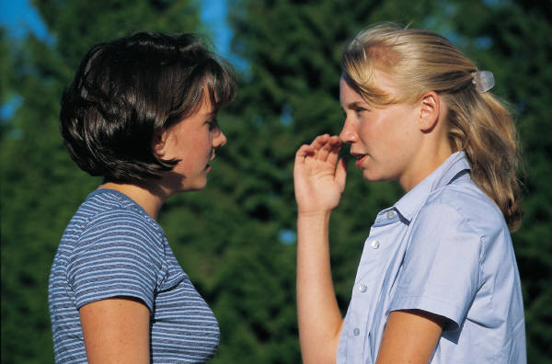
Edward Hugh Simpson’s Idea
Sometimes it is difficult to compare two or more items when talking to more than one person. One person’s notion of “large” may be another person’s “small”, so in order for scientists to understand each other, items can be measured or counted in a way that is universal to everyone. In order to understand how diverse an area is we can do a math problem that shows us in terms of a probability how diverse the area is.
Lets stop here and talk about probability!
Scientists needed a universally recognized method of comparison.
In 1949, a British statistician came up with an idea he published in the journal Nature:
  In order to understand how diverse an area is we can do a math problem that shows us in terms of a probability how diverse the area is!
Plot 1!
Plot 2!

Slide 19

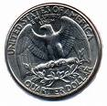
Probability is a way of expressing likelihood that an event will occur
For example: If I toss a coin how what is the probability of the coin landing on heads?
Let’s Review Probability:
Heads
Tails
One side of the quarter is heads and the other side of the quarter is tails, so we can say you have a half or ½ or 0.5 or 50% chance of the quarter landing on the heads side. Another way you can say this is you are about 50% sure the quarter will land on the side with the head.

Slide 20




Simpson’s Index of Biodiversity
Simpson’s Index is a way to express how diverse a sample is based on a probability.
The probability can be explained as follows:
If you close your eyes and pick out an individual organism from a sample and then you
repeat by closing your eyes and picking out another individual from your sample, what
is the probability that the organisms will be different species?
If the probability is high, for example 0.8 then you have an 80% chance of picking out
different species so you have high diversity in your sample.
1st Draw
Same or Different?
2nd Draw

Slide 21
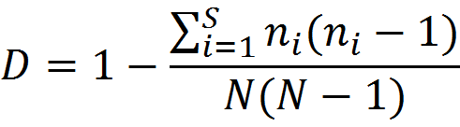
Simpson’s Index of Biodiversity
Let’s define the variables:
D= Simpsons Index of Diversity
Σ = summation
S= number of species
n_{i}= number of individuals within the i^{th} species
N= total number of individuals within the sample

Slide 22
Sigma What?
Let’s say you wanted to sum up a sequence of numbers:
species₁ + species₂ + species₃ + …+ n_{i} +…+ n_{S}
What mathematical notation would you use to make it easier to write that?

Slide 23

Sigma What?
Let’s say you wanted to sum up a sequence of numbers:
species₁ + species₂ + species₃ + …+ n_{i} +…+ n_{S}
What mathematical notation would you use to make it easier to write that? Summation Notation
Read it: “the sum of n_{i}, from i = 1 to S, where S is the total number of species”

Slide 24
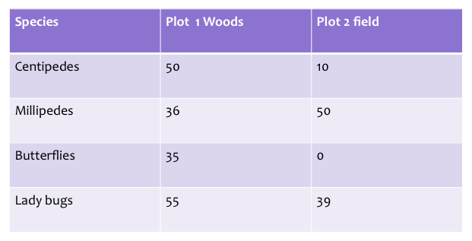
D= Simpsons Index of Diversity
Σ = summation
S= number of species
n_{i}= number of individuals within the i^{th} species
N= total number of individuals within the sample
Let’s calculate D for plot 1:
First do the numerator (top part):
*Use each observation to get count n, then multiply it by (n-1) and add those products together.
=(50(50-1)+36(36-1)+35(35-1)+55(55-1))
=50(49)+36(35)+35(34)+55(54)
=2450+1260+1190+2970
=7870

Slide 25

Next, let’s calculate the denominator:
Remember N = total number of individuals counting all species in your plot.
In plot 1:
50+36+35+55=176=N
For the denominator we have to calculate:
N(N-1) = 176(175)=30,800
Next let’s put it all together:
D = 1 - (0.256)
D = 0.744
So what does this mean? If you randomly pick two individuals in plot 1 you have a 74.4% chance of those two individuals being different species. We can say the diversity in the plot is high.

Slide 26
ON YOUR OWN:
Can you calculate Simpson’s Index for Plot 2?
Remember:
Start with the numerator
Then calculate the denominator
Then divide the numerator by denominator
Then subtract your fraction from 1
Which plot is more diverse based on your calculations?
Does this support or refute your hypothesis?

Slide 27
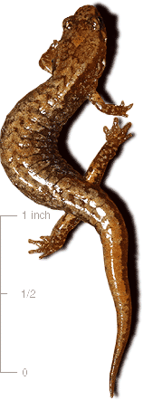
Looking for More?
Check out our second biodiversity module on real salamander data!
Look up on your own: Shannon’s Index of Biodiversity
Real datasets to compare available at www.handsontheland.org

Slide 28
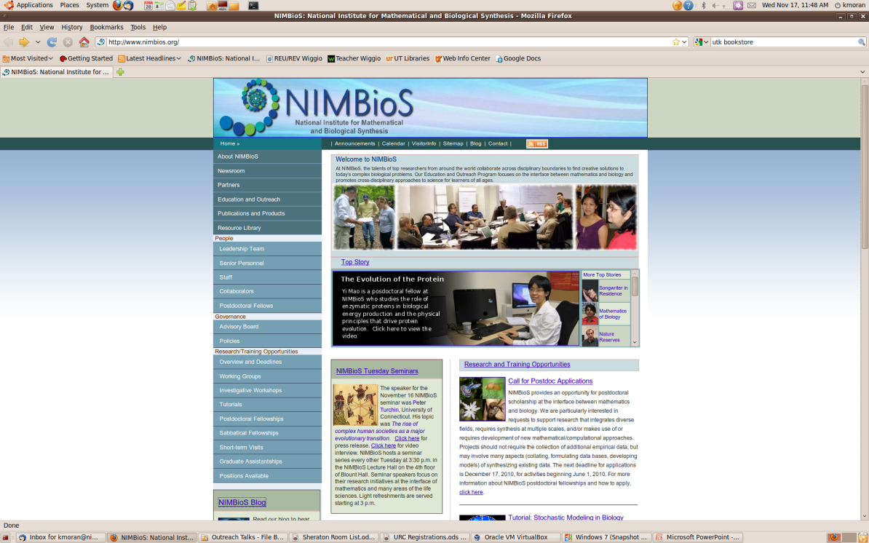
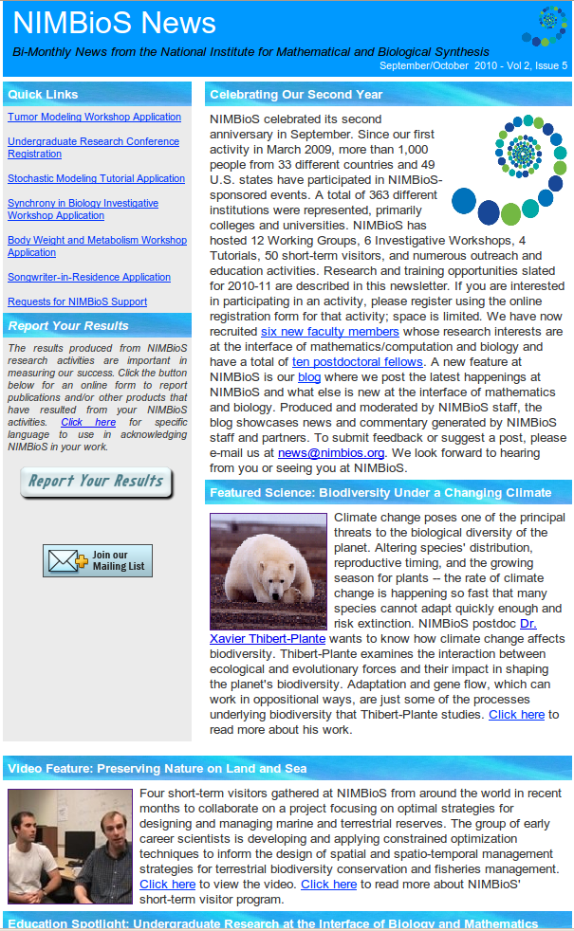
For The Biodiversity Module & More:
Website: www.nimbios.org
See what we’re all about
Sign up for our bimonthly email newsletter
Check our blog

