Slide 1

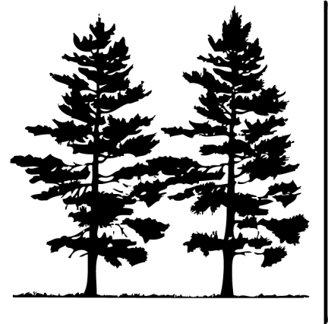


Biology Meets Math
Measuring a Forest
US Department of
Homeland Security
Notes:
1
1

Slide 2

Goals
Be able to describe the area and distribution of forests in the United States
Understand why it is important to measure and monitor forests
Define terms: biomass, crown, dendrologist, DBH
Find out what π (pi) has to do with measuring a tree
Define and calculate stand density

Slide 3
Area of Forests in US
In 2010, there were 304,022,000 ha of forest in the United States
The United States is 982,667,500 ha
What percent of the United States’ area is forested?

Slide 4
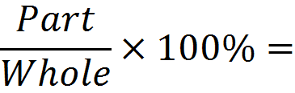
Area of Forests in US
In 2010, there were 304,022,000 ha of forest in the United States
The United States is 982,667,500 ha
What percent of the United States’ area is forested?

Slide 5
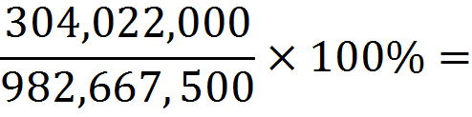
Area of Forests in US
In 2010, there were 304,022,000 ha of forest in the United States
The United States is 982,667,500 ha
What percent of the United States’ area is forested?

Slide 6
Area of Forests in US
In 2010, there were 304,022,000 ha of forest in the United States
The United States is 982,667,500 ha
What percent of the United States’ area is forested?
30.9%

Slide 7
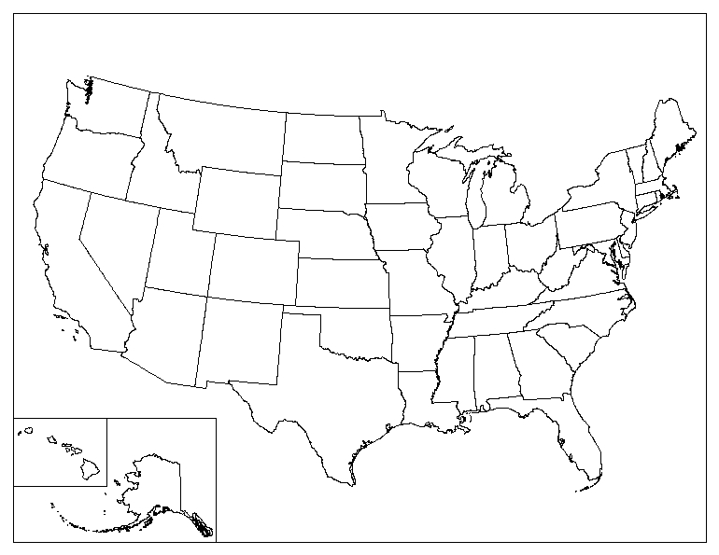
Where are the forests?

Slide 8
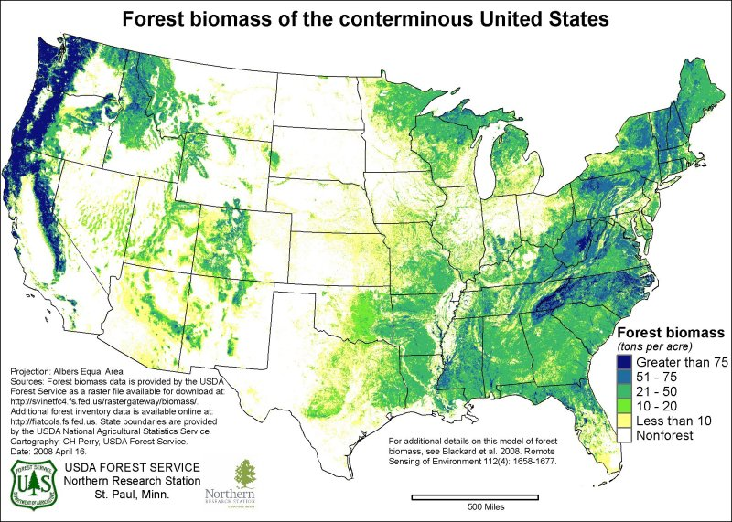
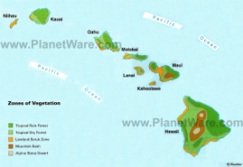
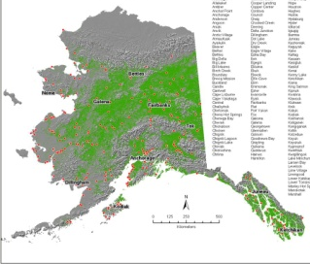
Distribution of Forests in the US
Biomass:
Biological material from living or recently living organisms (mass per unit area)
What areas have the most forest biomass?

Slide 9
Why do we measure and monitor forests?

Slide 10
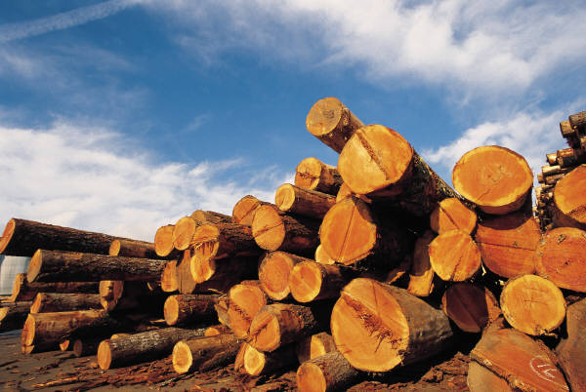
Why do we measure and monitor forests?
Timber and pulp

Slide 11
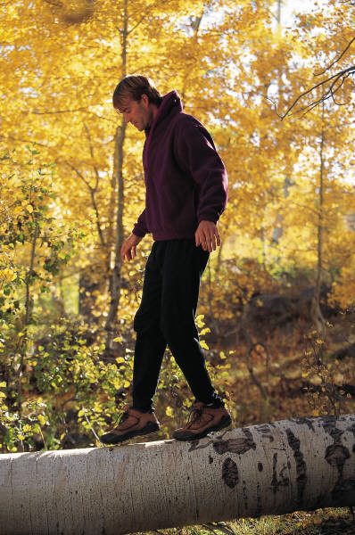
Why do we measure and monitor forests?
Timber and pulp
Recreation

Slide 12
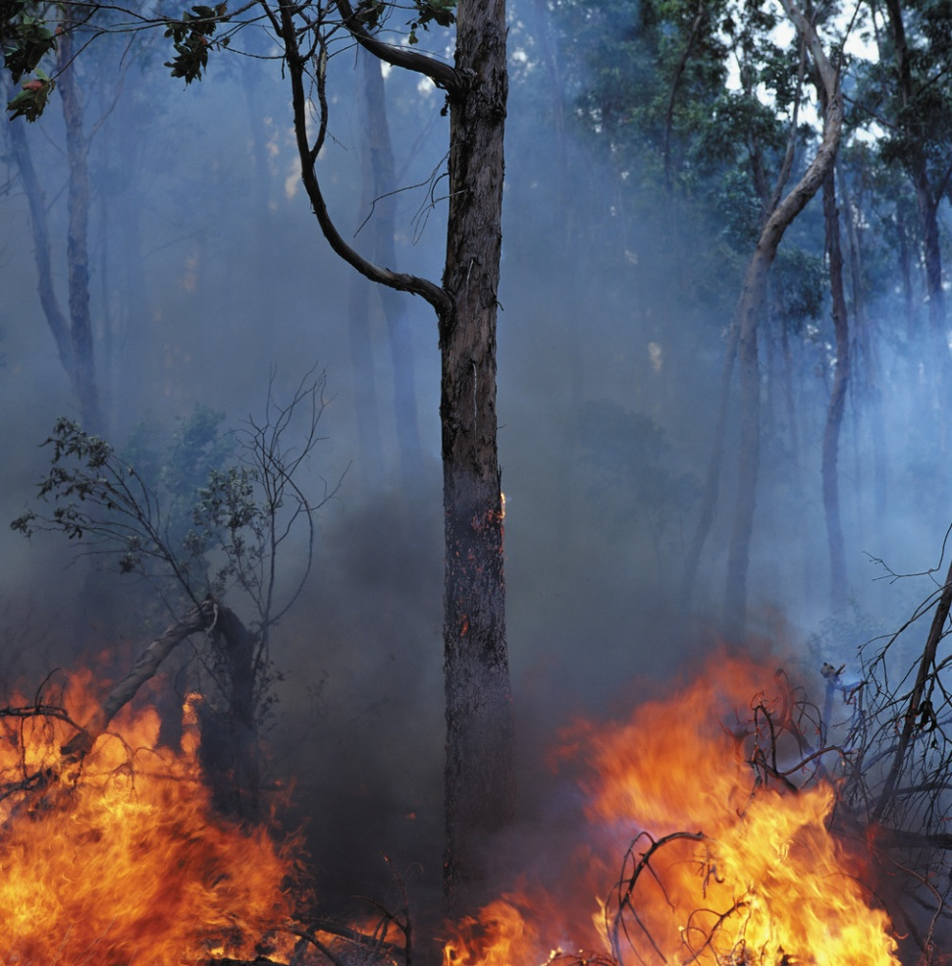
Why do we measure and monitor forests?
Timber and pulp
Recreation
Fire Management

Slide 13
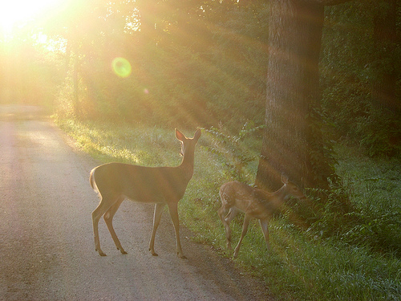
Why do we measure and monitor forests?
Timber and pulp
Recreation
Fire Management
Ecological Reasons
  Wildlife habitat

Slide 14
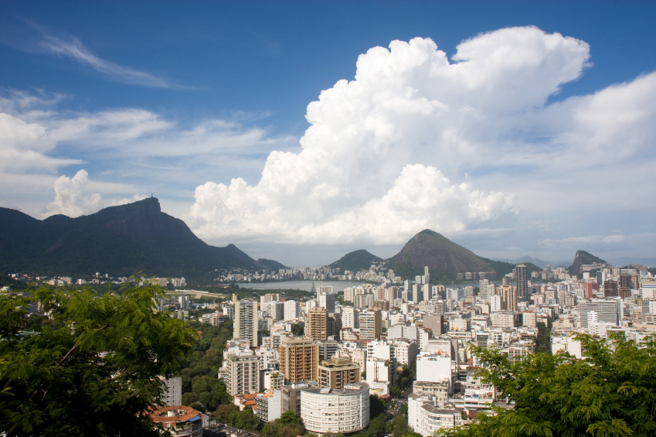
Why do we measure and monitor forests?
Timber and pulp
Recreation
Fire Management
Ecological Reasons
  Wildlife habitat
  Air quality

Slide 15
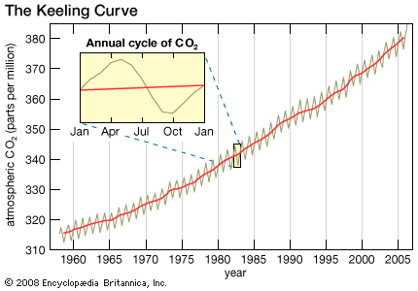
Why do we measure and monitor forests?
Timber and pulp
Recreation
Fire Management
Ecological Reasons
  Wildlife habitat
  Air quality
  Climate change

Slide 16
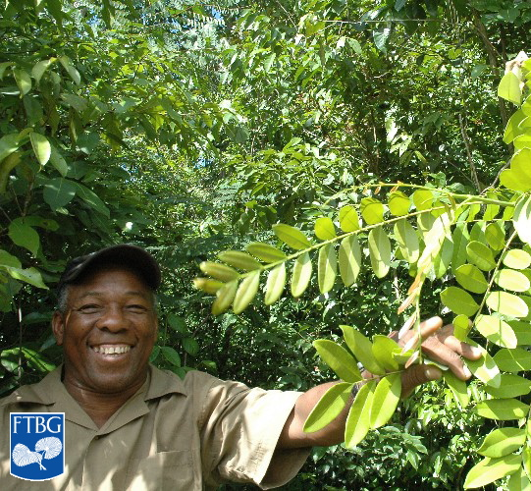
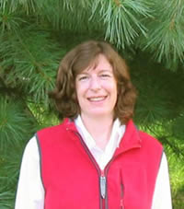

The Many Names of Forest Scientists
A forest scientist can have many different titles
One is a dendrologist, a person who studies trees and other woody plants
Dendro = (Greek: Tree or Tree-like)
Dowan Grant, Senior Forester and Dendrologist, Jamaican Forestry Department
http://www.virtualherbarium.org
Jennifer Franklin, Tree Physiologist, University of Tennessee
Emily Moran, Forest Ecologist, National Institute for Mathematical and Biological Synthesis

Slide 17
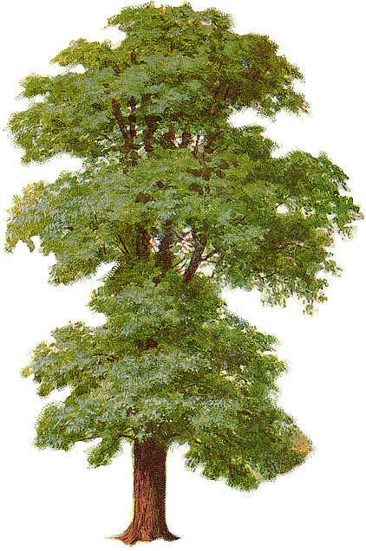
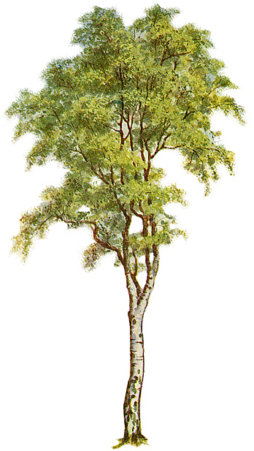
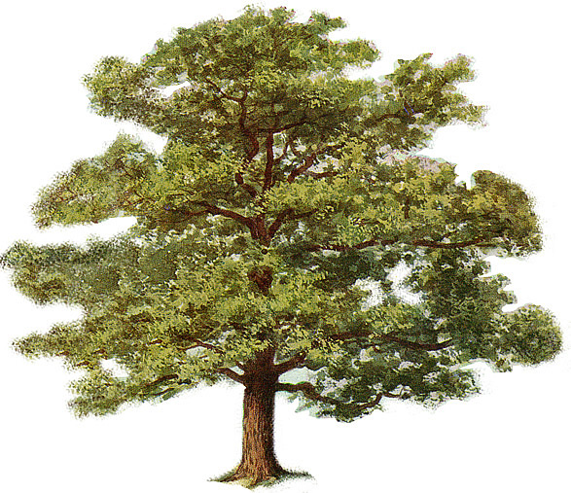
Measuring a Tree
We can see that trees come in all shapes and sizes …
Elm
Birch
Oak
… so how can we measure how they’re different?

Slide 18
Parts of the Tree
Pretend it’s a cylinder with an ellipsoid
Birch
Elm
Oak
We’ll call the ellipsoid the “crown”
And the cylinder the “trunk”

Slide 19
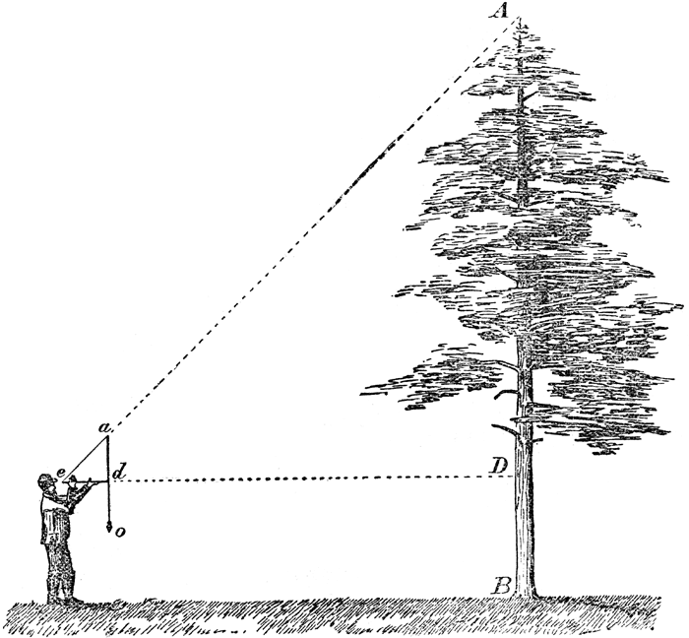
How do we measure something so big?

Slide 20
Common Height Measurements Dendrologists Make
Crown Height
Height
Height to Crown

Slide 21
Common Width Measurements Dendrologists Make
Width of Crown
Thickness of Trunk, aka “DBH”

Slide 22
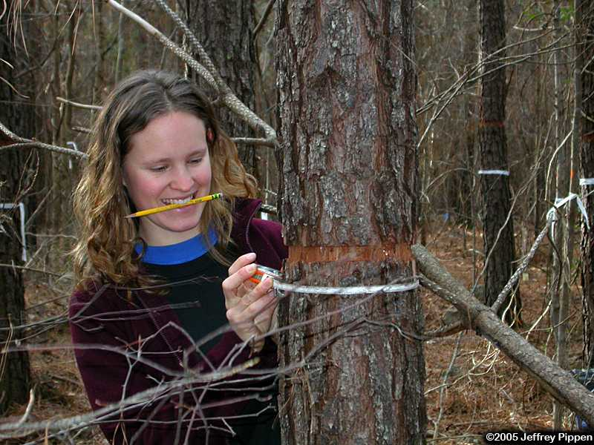
What is DBH?
Diameter at
Breast
Height
Diameter of the tree 4.5 feet above forest floor on the uphill side
Avoids the swell at the base of the trunk

Slide 23
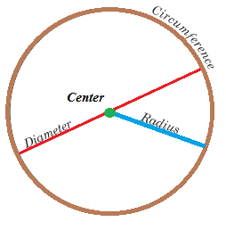
How can you use circumference to find diameter?

Slide 24
How can you use circumference to find diameter?
C = πD
C/π= D
Let’s Practice!

Slide 25
Practice with
Practice using C = πD
C = circumference
D = diameter
π ≈ 3.14
D = 2, C = ?
D = 6, C = ?
D=1, C = ?
C = 3.14, D = ?
Radius (R) = 3, D = ?
For every 1 inch increase in diameter, the circumference increases ____ inches.

Slide 26
Was it easy as π?
Practice using C = πD
C = circumference
D = diameter
π ≈ 3.14
D = 2, C = ? π * 2 ≈ 6.28
D = 6, C = ? π * 6 ≈ 18.84
D=1, C = ? π * 1 ≈ 3.14
C = 3.14, D = ? 3.14 / π = 1
Radius (R) = 3, D = ?
D=2R, so … 2 * 3 = 6
6. For every 1 inch increase in diameter, the circumference increases ~3.14 inches.

Slide 27
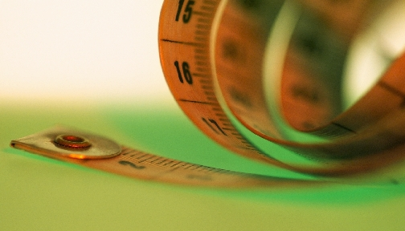
Problem & Solution
You are a forester collecting tree DBH data
You’d rather not bring a calculator into the field with you
Can you invent something that, if you use it to measure the circumference, it automatically gives you the diameter?

Slide 28
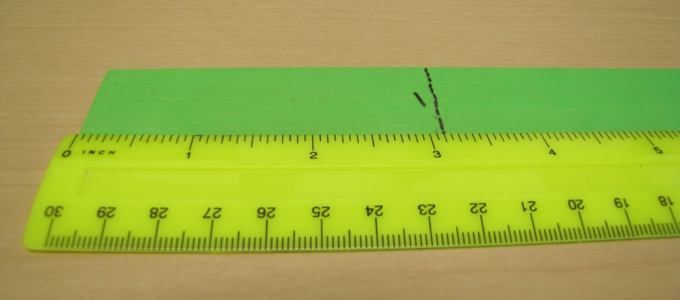
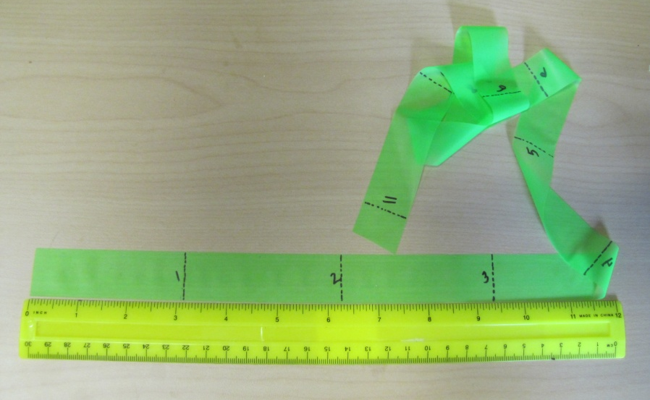
Make Your Own DBH Tape
Mark off every pi (3.14) inches
What is 0.14 of an inch?
Somewhere in between 1/8” and 3/16”
Test it out!

Slide 29
Test Your DBH Tape
What is the diameter of your tree cookie using a ruler?
What is the diameter of your tree cookie using your DBH tape?
What is the diameter of your head?
What is the diameter of your leg?

Slide 30
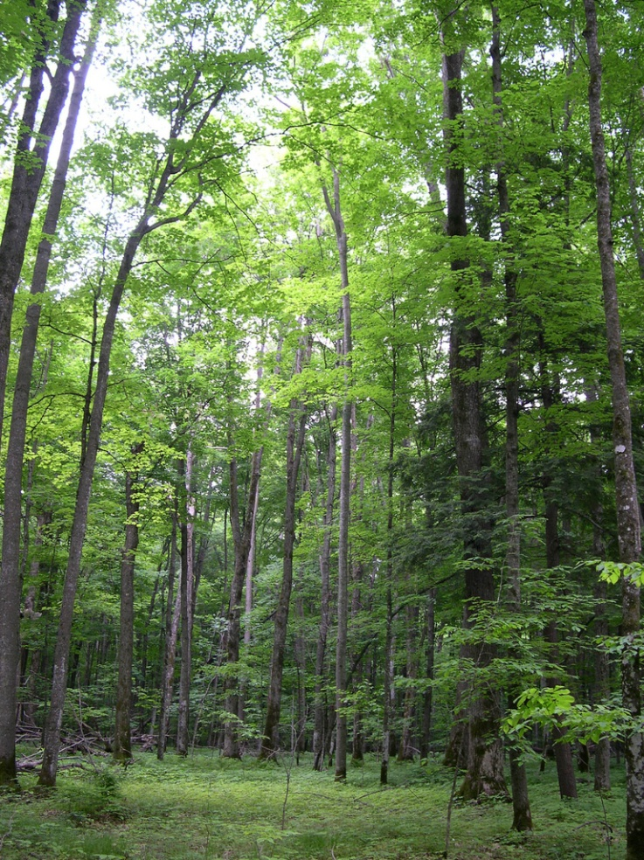
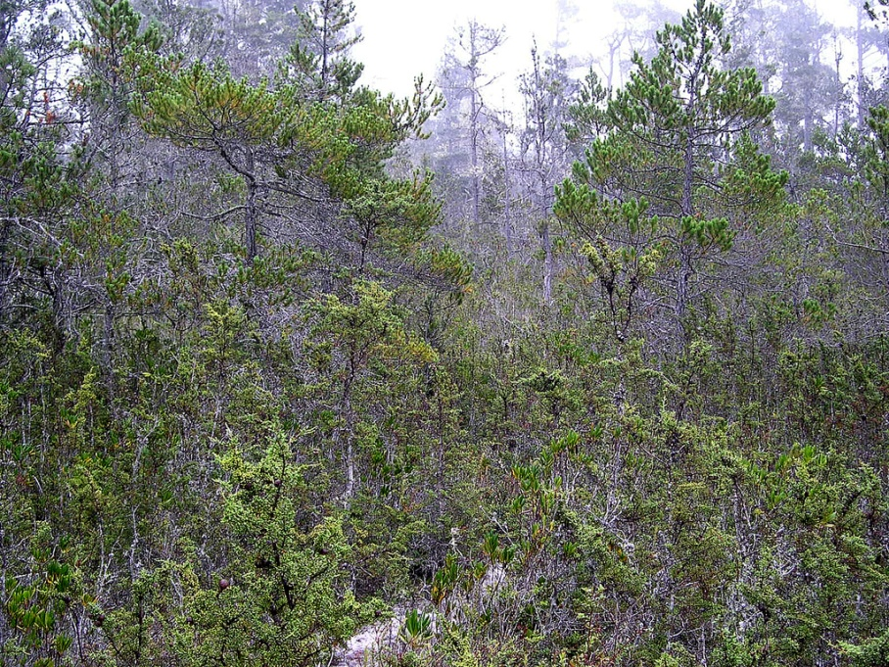
A Forest is Many Trees
Chequamegon National Forest, WI
Mendocino Pygmy Forest, CA
Forest A
Forest B
How to describe the difference with numbers?

Slide 31

Stand Density
15 ft
Count the number of trees (10)
Find the area (L*W) of the stand (15 ft * 25 ft = 375 ft²)
Divide the numerator by the denominator (10/375 = 0.03 trees/ft²)
25 ft
Aerial view of a forest plot, trunks only

Slide 32
Your Turn!
5 ft
8 ft
Aerial view of a forest plot, trunks only

Slide 33
Your Turn!
5 ft
Number of trees = 16 trees
Area of Stand: 5 ft*8 ft = 40 ft²
Stand Density = 16 trees/ 40 ft² = 0.4 trees/ft²
8 ft
Aerial view of a forest plot, trunks only

Slide 34
Which one has greater stand density?
Chequamegon National Forest, WI
Mendocino Pygmy Forest, CA
Forest A
Forest B
Probably Forest B!

Slide 35
A “Forest” of Humans
If the people in this classroom were trees, and this classroom were our plot …
What would be our stand density?

Slide 36
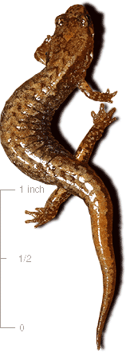
Looking for More?
Check out our modules on calculating biodiversity!
Real forest monitoring data available at
http://daac.ornl.gov/OTTER/guides/Runnings_Forest_BGC_Model.html

Slide 37
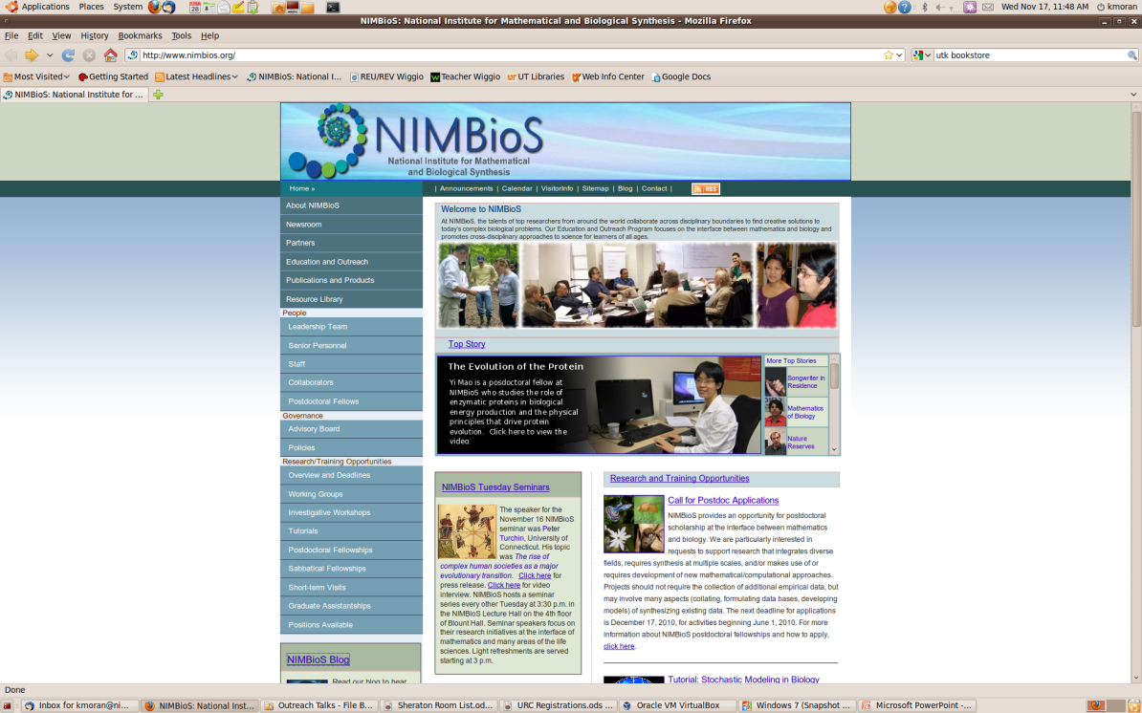
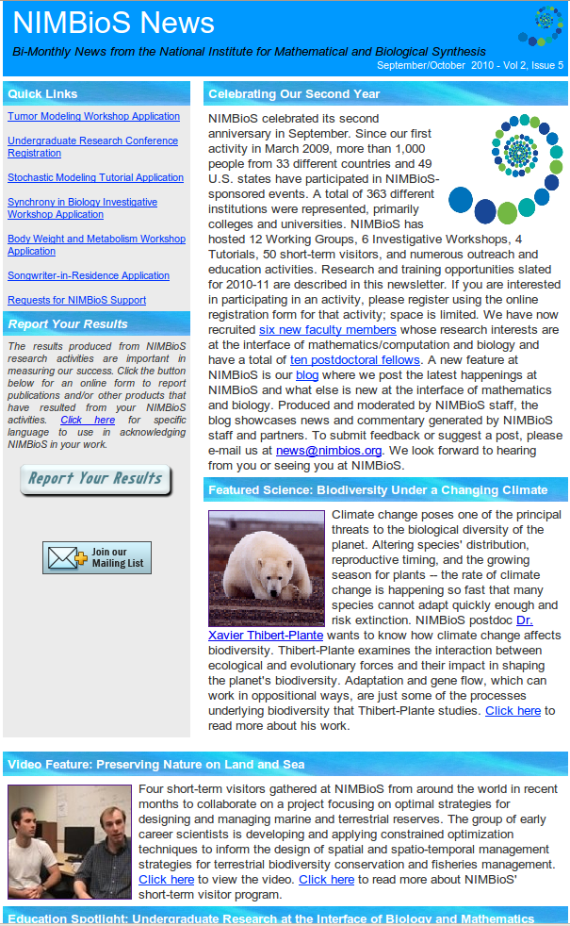
For this Module & More:
Website: www.nimbios.org
See what we’re all about
Sign up for our bimonthly email newsletter
Check our blog

