Slide 1
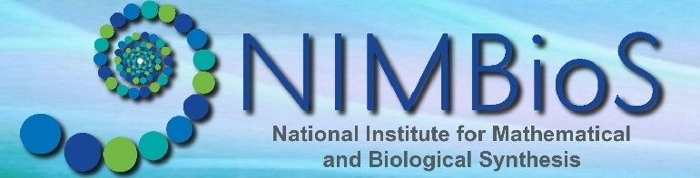
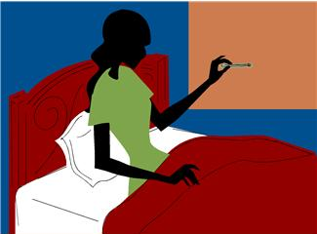


The Mathematics of Understanding Disease
Suzanne Lenhart, Associate Director for Education, Outreach & Diversity
Kelly Sturner, Education & Outreach Coordinator
Jennifer Richards, Hands On
US Department of
Homeland Security
Notes:
1
1

Slide 2
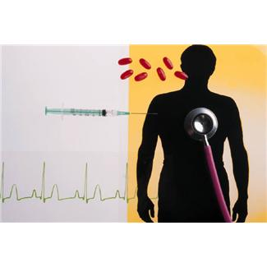
By the end of this module, you will …
Understand how mathematicians and biologists can build mathematical models to simulate disease outbreaks.
Use real world health data to learn and share something you choose about malaria.

Slide 3
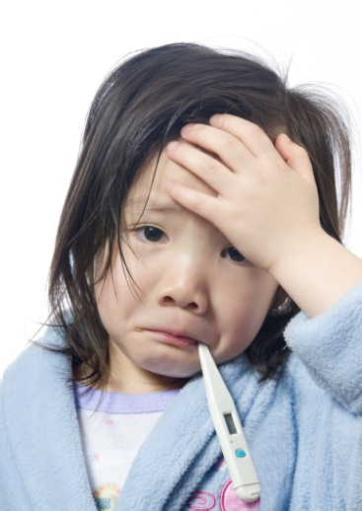
How can we quantify how fast a disease spreads?
Basic Reproductive Number = R_{o}
Expected number of secondary cases produced by a single infection in a completely susceptible population.
If R_{o} > 1, disease spreads

Slide 4

R₀ for some infectious diseases
Measles 12-18
Mumps 4-7
HIV/AIDS 2-5
Influenza 2-3

Slide 5
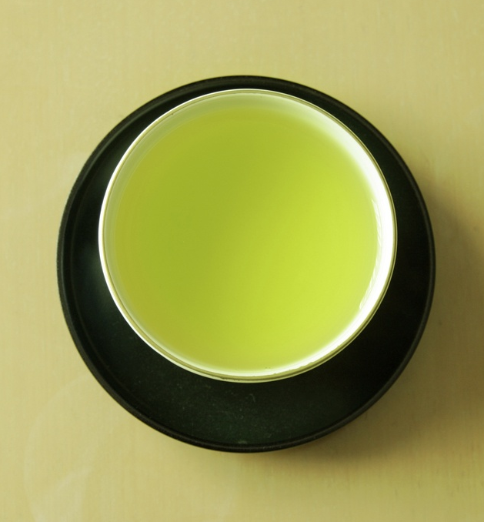
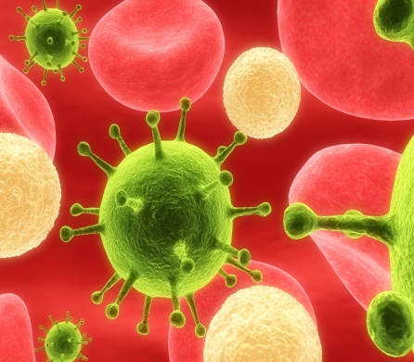
Outbreak in a Cup: Set Up
Set up the Initial Conditions:
20 red beans
1 white bean

Slide 6

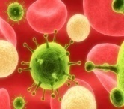
Outbreak in a Cup
1. Without looking in the cup, a student from the group selects 2 beans from the cup.
2. If both beans are the same color, simply return the beans.
3. If one bean is red and the other white, remove the red bean and return 2 white beans to the cup.
4. At each time step, record the event that occurs: either no change or a new infection.
5. Repeat the process until told to stop.

Slide 7
Share!
Did groups show different patterns in how the outbreaks occurred? Why or why not?
How is this disease model similar to what happens in the real world?
What aspects could we add to modify our simple model?
What would you estimate is the R₀ of this disease?
S
I
Susceptible
Infected

Slide 8
What do we mean by a Mathematical Model?
Real World
Occam’s Razor
Model World
Interpret and Test
Your Big Question
Model Results
Model
“A Purposeful Representation of Reality”
Figure from “A Course in Mathematical Modeling” by Mooney & Swift
Math

Slide 9
Some ways to add to this model …
S
I
R
Susceptible
Infected
Recovered
(Immune)
Dead
Can you think of more?
How would you represent them?
How could you represent these with math?

Slide 10
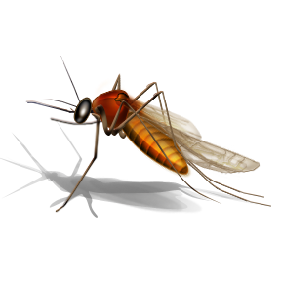
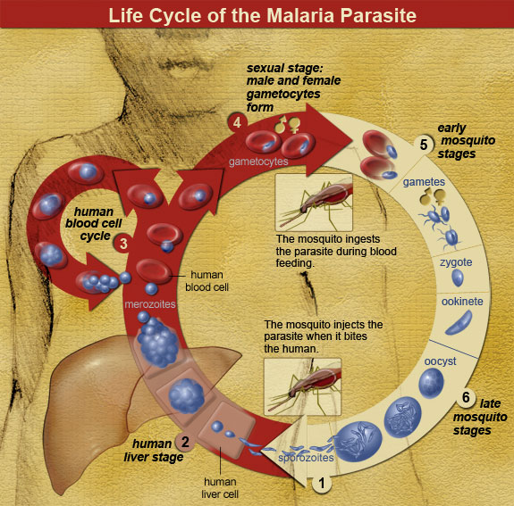
What is Malaria?
Components involved in malaria:
Parasite: Agent that causes the disease
Human: Host (suffers from the disease)
Mosquito: Vector that transmits the disease from human to human
Vector-borne disease
Cause: Plasmodium falciparum, Plasmodium vivax, Plasmodium malariae, Plasmodium ovale
Plasmodium falciparum is the most dangerous species
Transmission: Female mosquito
Male and female mosquitoes feed on nectar and plant juice
Female mosquitoes need blood for reproduction

Slide 11

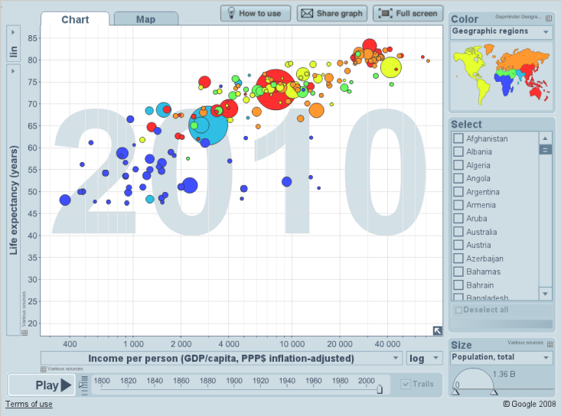
Gapminder is a free data exploration and visualization tool
Lots of world data from sources such as WHO, FAO, others are loaded into it
Use it to find your own interesting trends

Slide 12
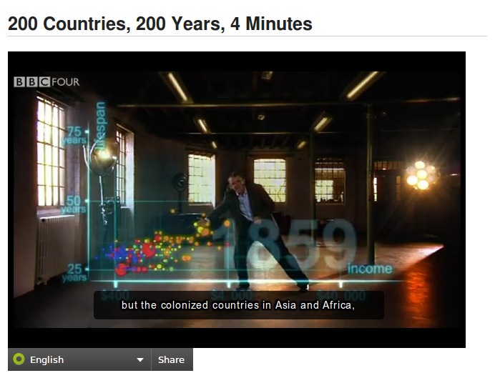
Getting Started
Watch the introductory video:
http://www.gapminder.org/videos/200-years-that-changed-the-world-bc/
Open Gapminder World
Check out the tutorial on the next slide (or click “How to Use”)
Use the spreadsheet to start thinking about malaria

Slide 13
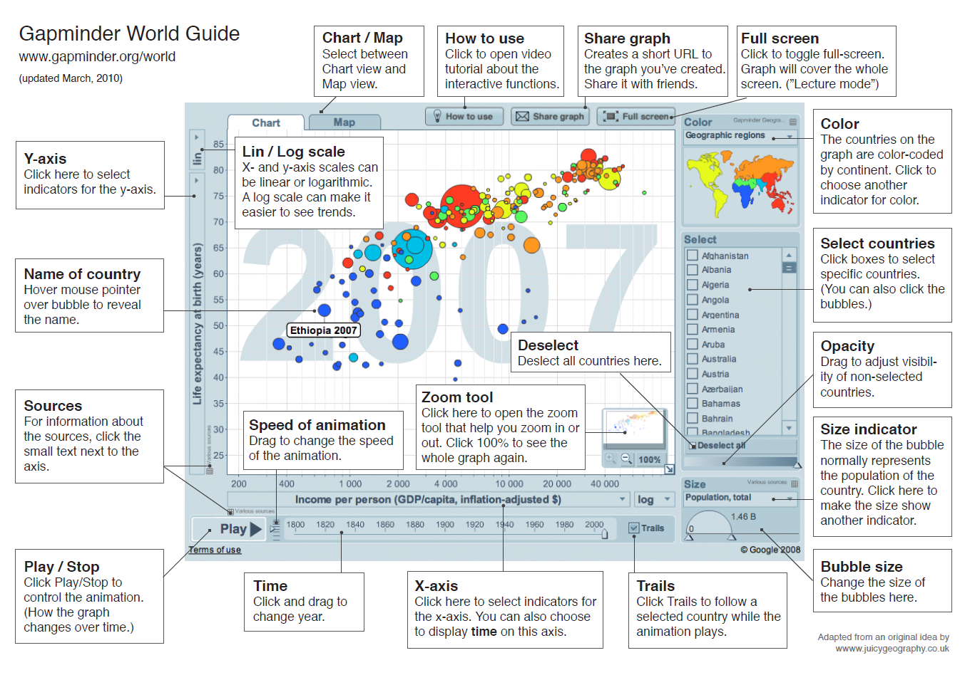
From Gapminder World Website

Slide 14
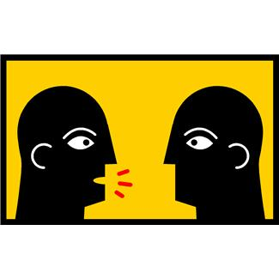
Share Your Findings

Slide 15

Effects of Malaria
Effects range from mild to fatal, including cerebral malaria
About 1.24 million deaths in 2010 (Murray et al. 2012)
In Africa, a child dies every 45 seconds of Malaria
Malaria prevalence is high in developing countries due to:
poverty,
human behavior,
poor sanitation,
inadequate drainage,
drug resistance, etc.
Malaria has a negative impact on economic growth.
People moving from regions without malaria to regions where it is present are more at risk

Slide 16
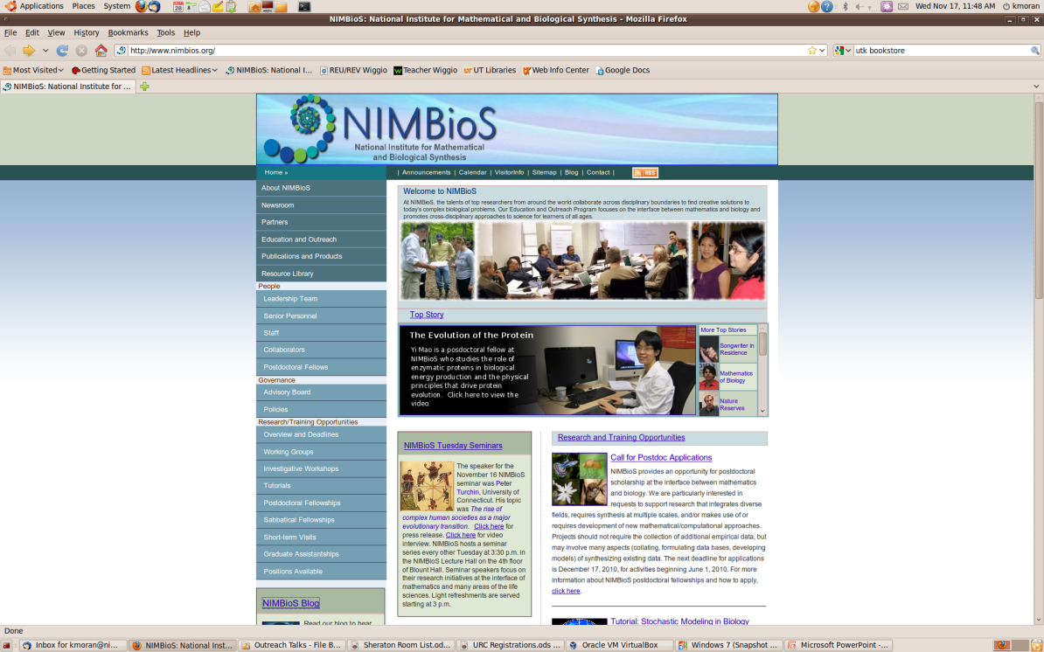
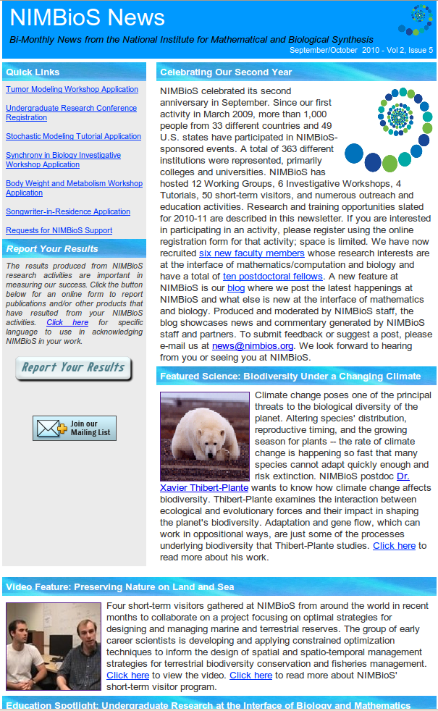
For This Module & More …
Website: www.nimbios.org
Sign up for our bimonthly email newsletter
Check our blog

Slide 17
Acknowledgements
Disease modeling activity adapted from:
Jungck, J.R., Gaff, H. and A.E. Weisstein. 2010. Mathematical Manipulative Models: In Defense of “Beanbag Biology”. CBE-Life Sciences 9(3): 201-211.
Slides on Malaria disease adapted with permission from:
Dr. Calistus Ngonghala, NIMBioS postdoctoral researcher
And for the excellent data tool, video, tutorial resources:
Dr. Hans Rosling and www.gapminder.org
This module developed and piloted for:
Tennessee Junior Science and Humanities Symposium 2012

