Slide 1

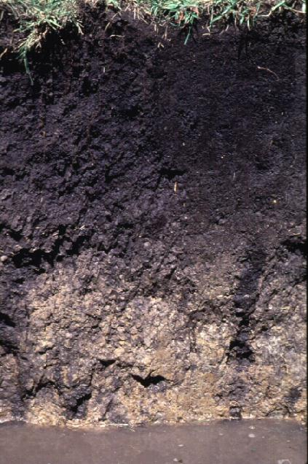

Biology Meets Math
Predator-Prey Relationships
in Belowground Ecosystems
US Department of
Homeland Security
Notes:
1
1

Slide 2
Goals:
Define Predator and Prey in relation to soil ecology
Define a mathematical model and identify some examples when one is useful
Create a hypothesis
Explain the basics behind the given simple Predator-Prey Relationship Model
Graph the results of the given model
Use your results to support or refute your hypothesis

Slide 3
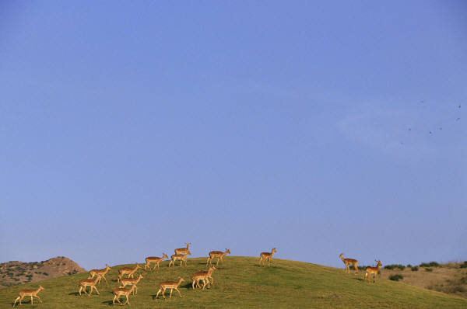
Predators & Prey
Predator: an organism that hunts, kills and eats other organisms (prey) to survive
Prey: an organism hunted and taken as food

Slide 4
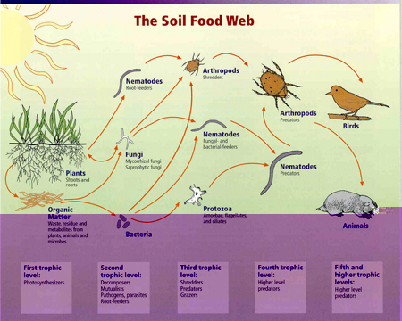
In the Soil ….
Predation happens on a variety of scales
Source: TIEE (ESA)
“Where the telescope ends, the microscope begins. Which of the two has the grander view?” -- Victor Hugo

Slide 5
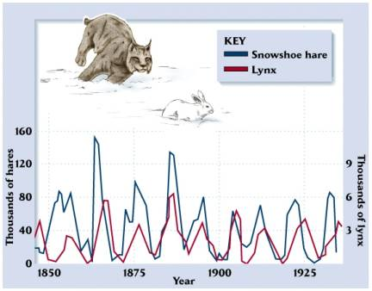
Classic Predator-Prey
Canadian lynxes and hares
Fur trapping data
Controversial!
Theoretically you’d expect prey to peak before predators every time
Let’s get help from a model!

Slide 6



Do these models look helpful?

Slide 7
So what do we mean by a Model?

Slide 8
You’re a Modeler!
Have you ever calculated how much gas it’s going to take you to get somewhere?
Have you ever estimated how long it’ll take you to save up for something?
Picked the best line at the grocery store?
Others?

Slide 9
Brace Yourself for Math!
(Trust Me, You Can Do It!)
Math Anxiety

Slide 10
What do we mean by a Mathematical Model?
Real World
Occam’s Razor
Model World
Interpret and Test
Your Big Question
Model Results
Model
“A Purposeful Representation of Reality”
Figure from “A Course in Mathematical Modeling” by Mooney & Swift
Math

Slide 11
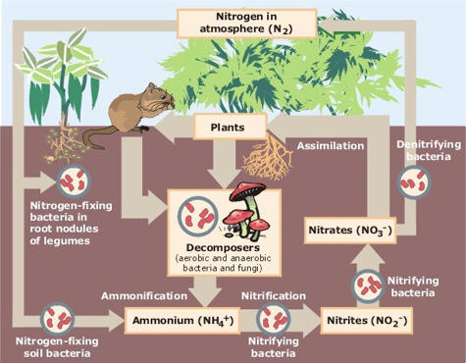
Soil Biologists Use Models
Nutrient cycling
Decomposition
Carbon sequestration
Predator-Prey
Host-parasite
Soil formation/erosion

Slide 12
Some Kinds of Models
Stochastic Model: Has randomness!
Discrete Model: No randomness
Theoretical Model: for explaining observed phenomena
Deterministic Model: for predicting events in time

Slide 13
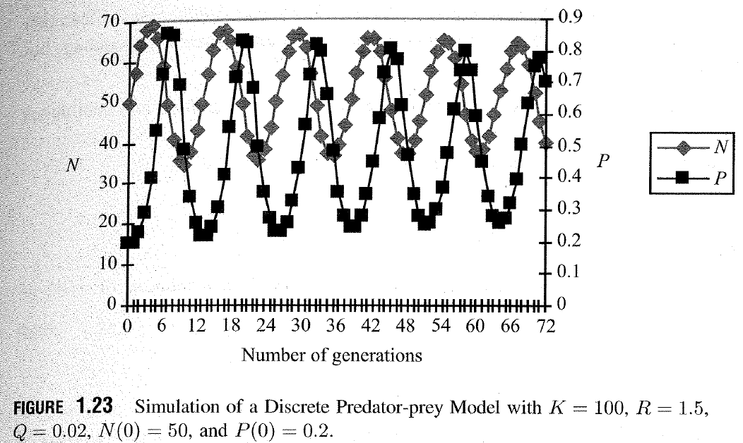
Theoretical Predator-Prey
How did they do it?

Slide 14
The Mathematical Model
Terms:
N_{n} Your prey population at the moment (time step n)

Slide 15
The Mathematical Model
Terms:
N_{n} Your prey population at the moment (time step n)
N_{n+1} Your prey population at the next time step

Slide 16
The Mathematical Model
Terms:
N_{n} Your prey population at the moment (time step n)
N_{n+1} Your prey population at the next time step
R The prey population’s growth rate

Slide 17
The Mathematical Model
Terms:
N_{n} Your prey population at the moment (time step n)
N_{n+1} Your prey population at the next time step
R The prey population’s growth rate
K The prey’s carrying capacity

Slide 18
The Mathematical Model
Terms:
N_{n} Your prey population at the moment (time step n)
N_{n+1} Your prey population at the next time step
R The prey population’s growth rate
K The prey’s carrying capacity
C The predator’s efficiency in nabbing prey

Slide 19
The Mathematical Model
Terms:
N_{n} Your prey population at the moment (time step n)
N_{n+1} Your prey population at the next time step
R The prey population’s growth rate
K The prey’s carrying capacity
C The predator’s efficiency in nabbing prey
P_{n} Your predator population

Slide 20
The Mathematical Model
Terms:
N_{n} Your prey population at the moment (time step n)
N_{n+1} Your prey population at the next time step
R The prey population’s growth rate
K The prey’s carrying capacity
C The predator’s efficiency in nabbing prey
P_{n} Your predator population
Q The predator’s efficiency in using prey to reproduce

Slide 21
How Do You Expect These to Relate?
If the prey population growth rate is positive, what do you expect will happen to the population of prey over time?
As the prey population reaches its carrying capacity, what do you expect will happen to the prey population?
As the predator’s efficiency in getting prey goes up, what do you expect will happen to the prey population?
As the predator’s population goes up, what do you expect will happen to the prey population?
As the prey population goes up, what do you expect will happen to the predator population?
As the predator’s efficiency in using energy it gets from prey to reproduce goes up, what would happen to the prey population?

Slide 22
How Do You Expect These to Relate?
If the prey population growth rate is positive, what do you expect will happen to the population of prey over time? Prey population goes up.
As the prey population reaches its carrying capacity, what do you expect will happen to the prey population? Prey growth slows down.
As the predator’s efficiency in getting prey goes up, what do you expect will happen to the prey population? Prey population goes down.
As the predator’s population goes up, what do you expect will happen to the prey population? Prey population slows down or goes down.
As the prey population goes up, what do you expect will happen to the predator population? Predator population goes up.
As the predator’s efficiency in using energy it gets from prey to reproduce goes up, what would happen to the predator population? Predator population goes up.

Slide 23

Introducing … what you just said
Existing Prey Population
Growth of Prey Population
Prey Population Gets Pulled Down by Predators
What about the predator population?

Slide 24

Hello Predators!
Growth of Predator Population

Slide 25
Does this actually work?
Let’s plug some stuff in!
Assumptions:
K =100
R = 1.5
Q = 0.02
N₀= 50
P = 0.2
C = 3

Slide 26
Answer Key
Time Step (n) | N (Prey Population) | P (Predator Density)
0 | 50.0 | 0.20
1 | 57.5 | 0.20
2 | 59.7 | 0.23
3 | 54.6 | 0.27
4 | 47.6 | 0.29
5 | 43.6 | 0.28
6 | 43.9 | 0.24
7 | 49.2 | 0.21
8 | 55.7 | 0.21
9 | 57.6 | 0.23
10 | 54.5 | 0.26

Slide 27
Goals:
Play with a Predator-Prey Model using Netlogo (free online software!)
Have some free-wheeling inquiry-based fun

Slide 28
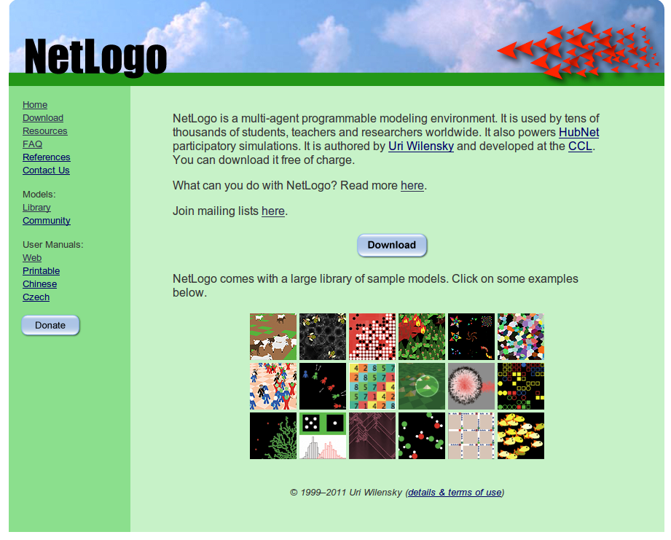
Computers: An Easier Way to Model
Go to website:
ccl.northwestern.edu/netlogo/
Download the program
Pay attention to what folder the program downloads into. Then put the file
Bacteria Protozoa Predation.nlogo
in the same folder

Slide 29
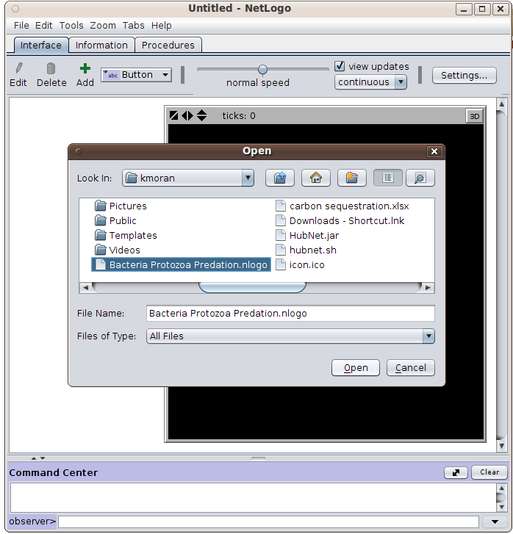
Open the Model
Run Netlogo
Go to File → Open
Find the Bacteria Protozoa file
Select Open

Slide 30
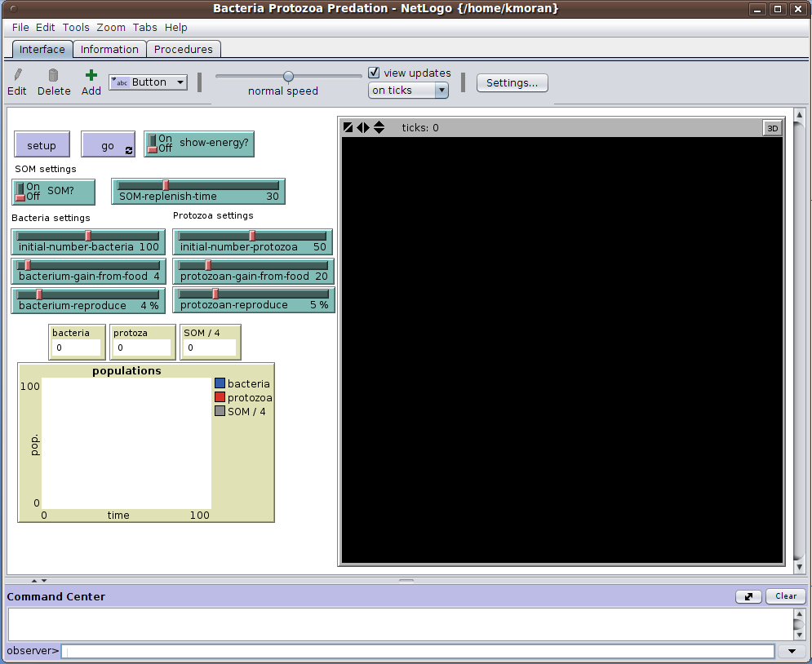
Netlogo Interface
Check it out!
To run …
Press the Setup button

Slide 31
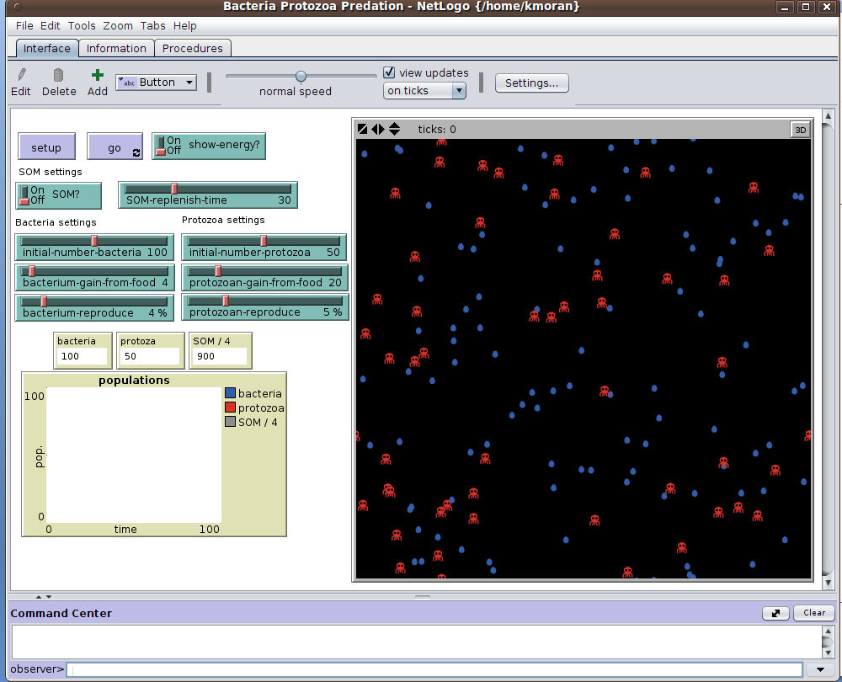
Netlogo Interface
Check it out!
To run …
Press the Setup button
Press the Go button

Slide 32
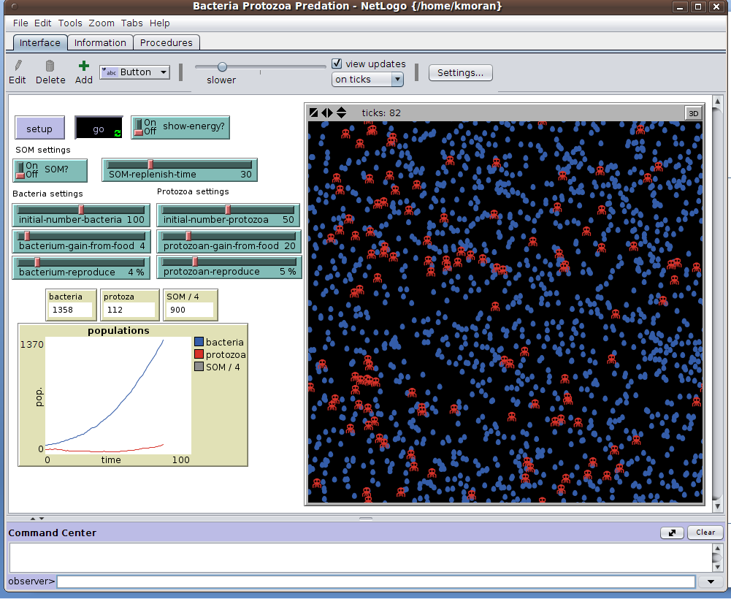
Netlogo Interface
Check it out!
To run …
Press the Setup button
Press the Go button
And watch what happens!

Slide 33
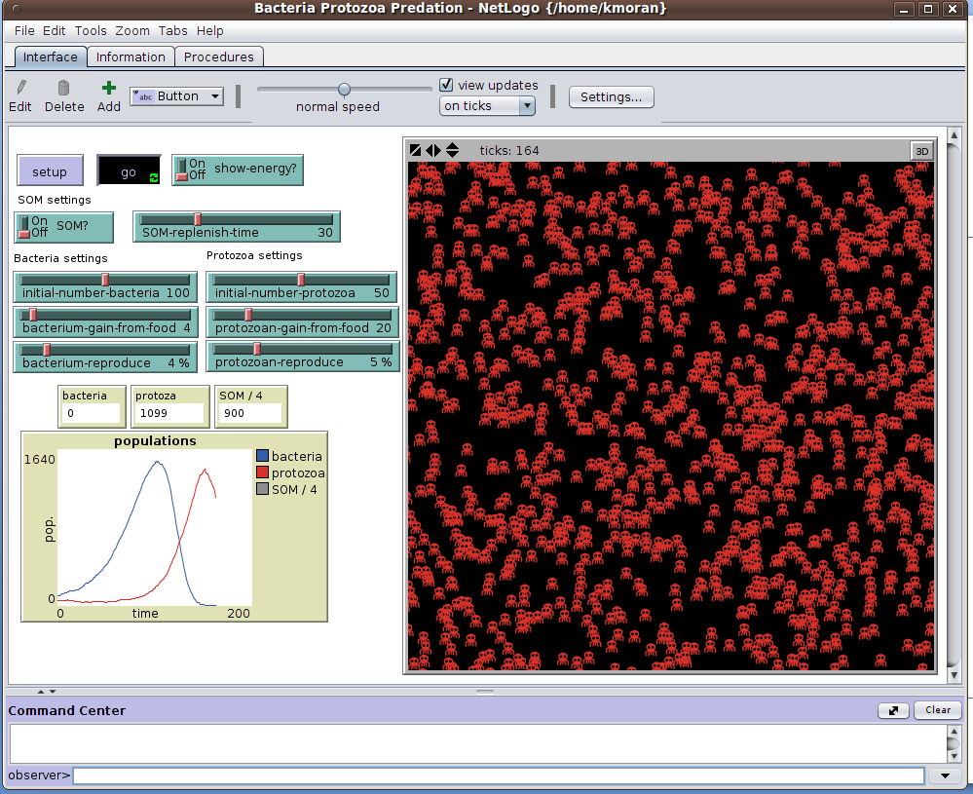
Netlogo Interface
Check it out!
To run …
Press the Setup button
Press the Go button
And watch what happens!
Oh my.

Slide 34
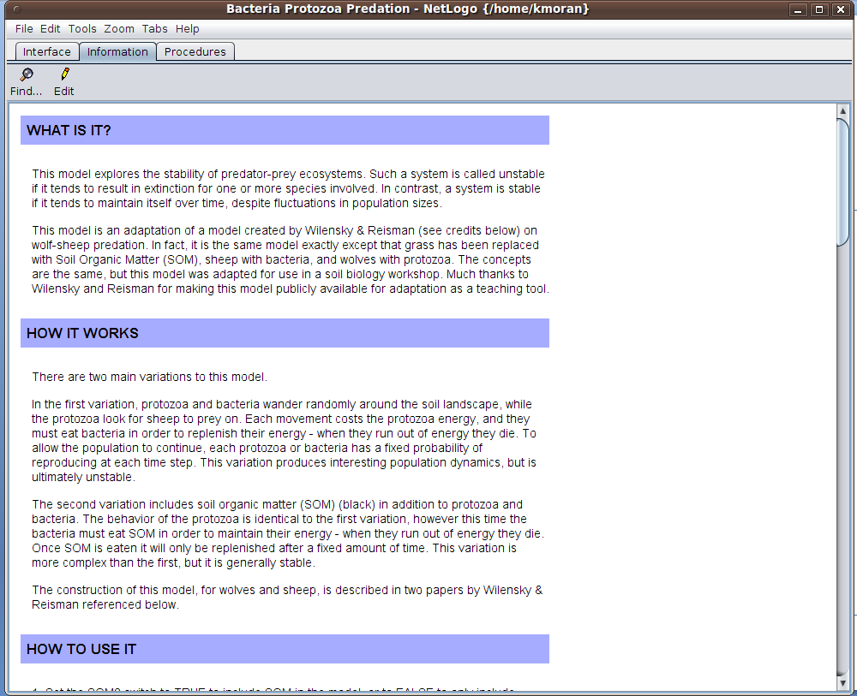
Background on the Model
Select the Information tab, and read about this model
Then work through the worksheet

Slide 35
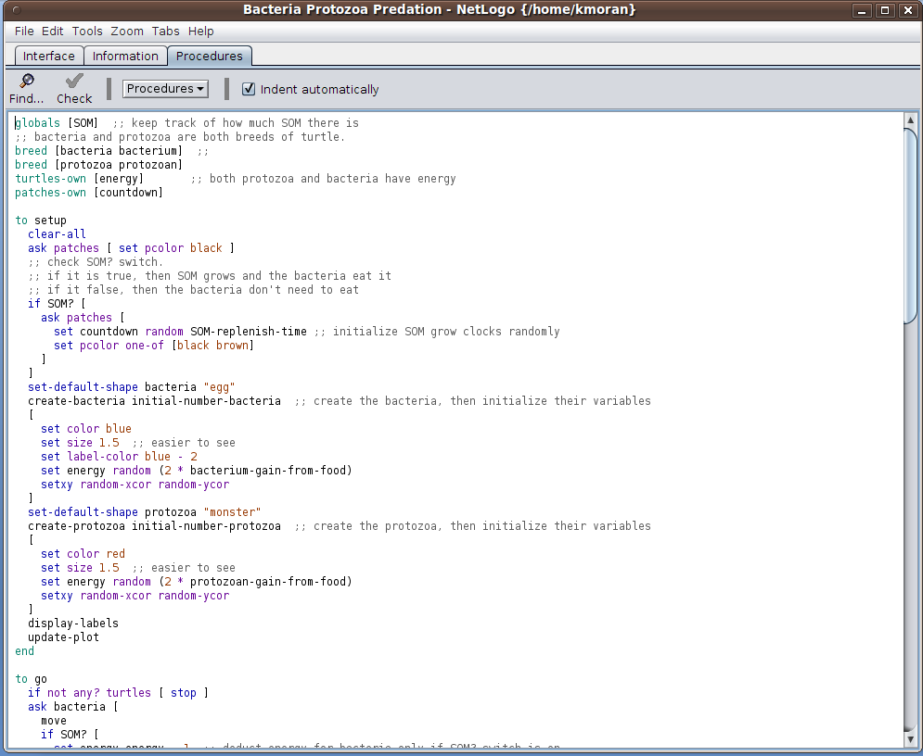
Need More Challenge?
Click on the Procedures tab
See the computer codes that make the model work
Tutorial available on the Netlogo website

Slide 36
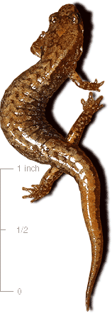
Looking for More?
Check out our modules on quantifying biodiversity and measuring a forest!

Slide 37
Sources
Charles J. Krebs. Ecology: The Experimental Analysis of Distribution and Abundance. Harper and Row Publishers, New York, second edition, 1978.
Douglas Mooney & Randall Swift. A Course in Mathematical Modeling. The Mathematical Association of America, 1999.
Netlogo copyright 1997 Uri Wilensky. See http://ccl.northwestern.edu/netlogo/models/WolfSheepPredation for terms of use.

Slide 38
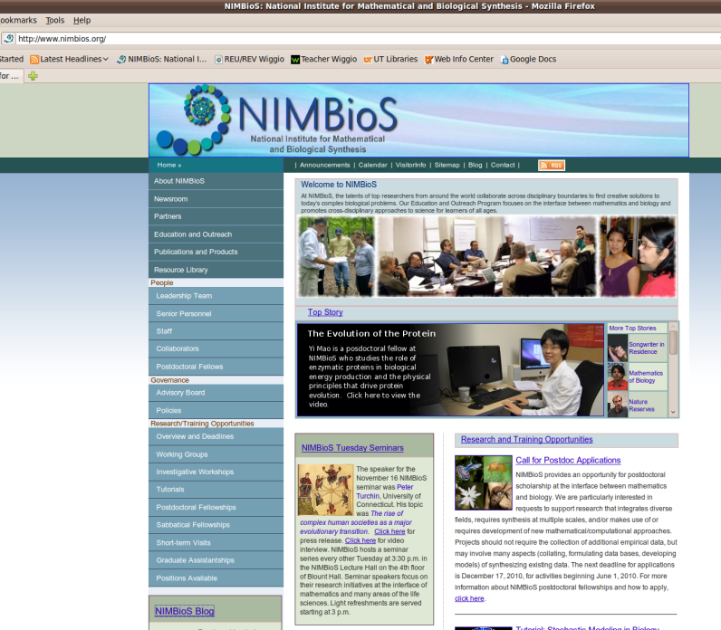
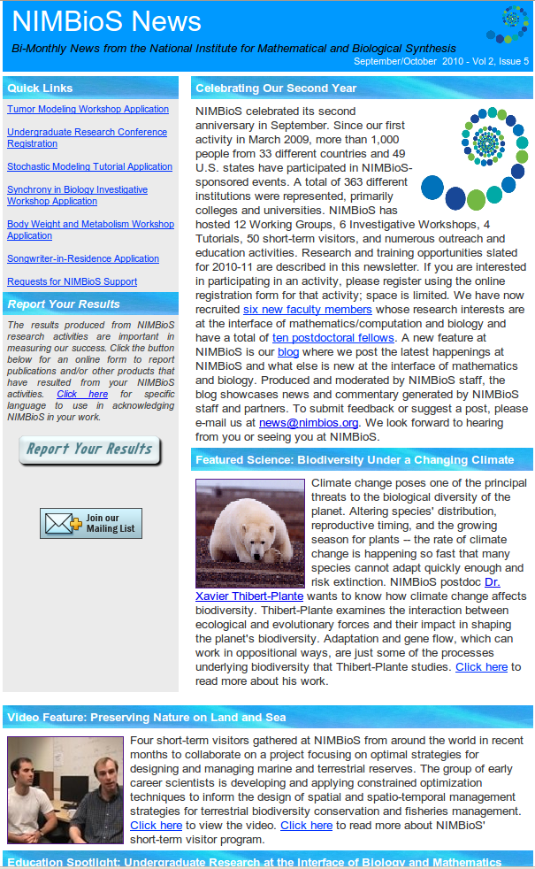
For this Module & More:
Website: www.nimbios.org
See what we’re all about
Sign up for our bimonthly email newsletter
Check our blog

